Slide 1


Slide 2
Presentation Skills - Design of Posters and Setting Ground Rules

Slide 3
CONTENT
Basic principles
1. Understanding the Importance of Poster Design
2. Principles of Effective Poster Design
3. Setting Ground Rules for Presentations
4. Best Practices for Poster Presentations

Slide 4
BASIC PRINCIPLES
A poster is a virtual presentation of information – do not simply reproduce your written paper in poster format
It should be understandable to the reader without verbal comment – someone might look at it while you are not there to explain
Remember your poster objectives
Grab attention
Tell them what the poster is about simply

Slide 5
Understanding the Importance of Poster Design

Slide 6



The Role of Visual Communication in Presentations
Clarifying Complex Concepts
Visual elements such as charts, graphs, and images simplify intricate ideas, enabling presenters to convey messages more clearly and ensuring that the audience grasps the essential information.
Enhancing Audience Engagement
Visual communication captures attention and maintains interest, making it easier for audiences to connect with the content being presented.
Facilitating Information Retention
Well-designed visuals aid memory retention by providing clear and memorable representations of complex information, allowing audiences to recall key points more effectively.

Slide 7
Key Elements of Effective Poster Design
Clear and Concise Messaging
Effective posters communicate their main message quickly and clearly, using minimal text to ensure that viewers can grasp the key points at a glance
Visual Hierarchy and Layout
A well-structured layout guides the viewer's eye through the poster, utilizing size, color, and placement to emphasize important information and create a logical flow of content.
Appropriate Use of Color and Imagery
Strategic use of color and relevant images enhances visual appeal and reinforces the message, while ensuring that the design remains professional and accessible to the target audience.

Slide 8
Common Mistakes to Avoid in Poster Design
02
Neglecting Visual Hierarchy
Failing to establish a clear visual hierarchy can lead to confusion; use size, color, and placement strategically to guide the audience's attention to the most important elements.
03
Ignoring Audience Needs
Designing without considering the target audience's preferences and understanding can result in ineffective communication; tailor your design choices to resonate with the specific audience for better engagement.
01
Overloading with Text
Including too much text can overwhelm viewers, making it difficult for them to identify key messages; aim for brevity and clarity to enhance comprehension.

Slide 9



Tools and Resources for Designing Posters
Graphic Design Software
Utilize tools like Adobe Illustrator, Canva, or Inkscape to create professional-quality posters with customizable templates, allowing for flexibility in design and layout.
Stock Image Libraries
Access resources such as Unsplash, Shutterstock, or Pixabay for high-quality images and graphics that can enhance visual appeal and support the message of your poster.
Typography Resources
Explore websites like Google Fonts or Adobe Fonts to find a wide variety of typefaces that can improve readability and aesthetic quality, ensuring your text complements the overall design.

Slide 10
Principles of Effective Poster Design

Slide 11
Layout and Composition Techniques
01
Balance and Symmetry
Achieving a balanced layout ensures that visual elements are evenly distributed, creating a sense of harmony that draws the viewer's eye and enhances overall readability.
02
Grid Systems for Structure
Utilizing grid systems helps organize content systematically, allowing for consistent alignment and spacing, which improves the flow of information and guides the audience through the poster.
03
Focal Points and Visual Flow
Establishing focal points directs attention to key messages or images, while a well-planned visual flow leads the viewer's gaze naturally across the poster, ensuring that important information is not overlooked.

Slide 12
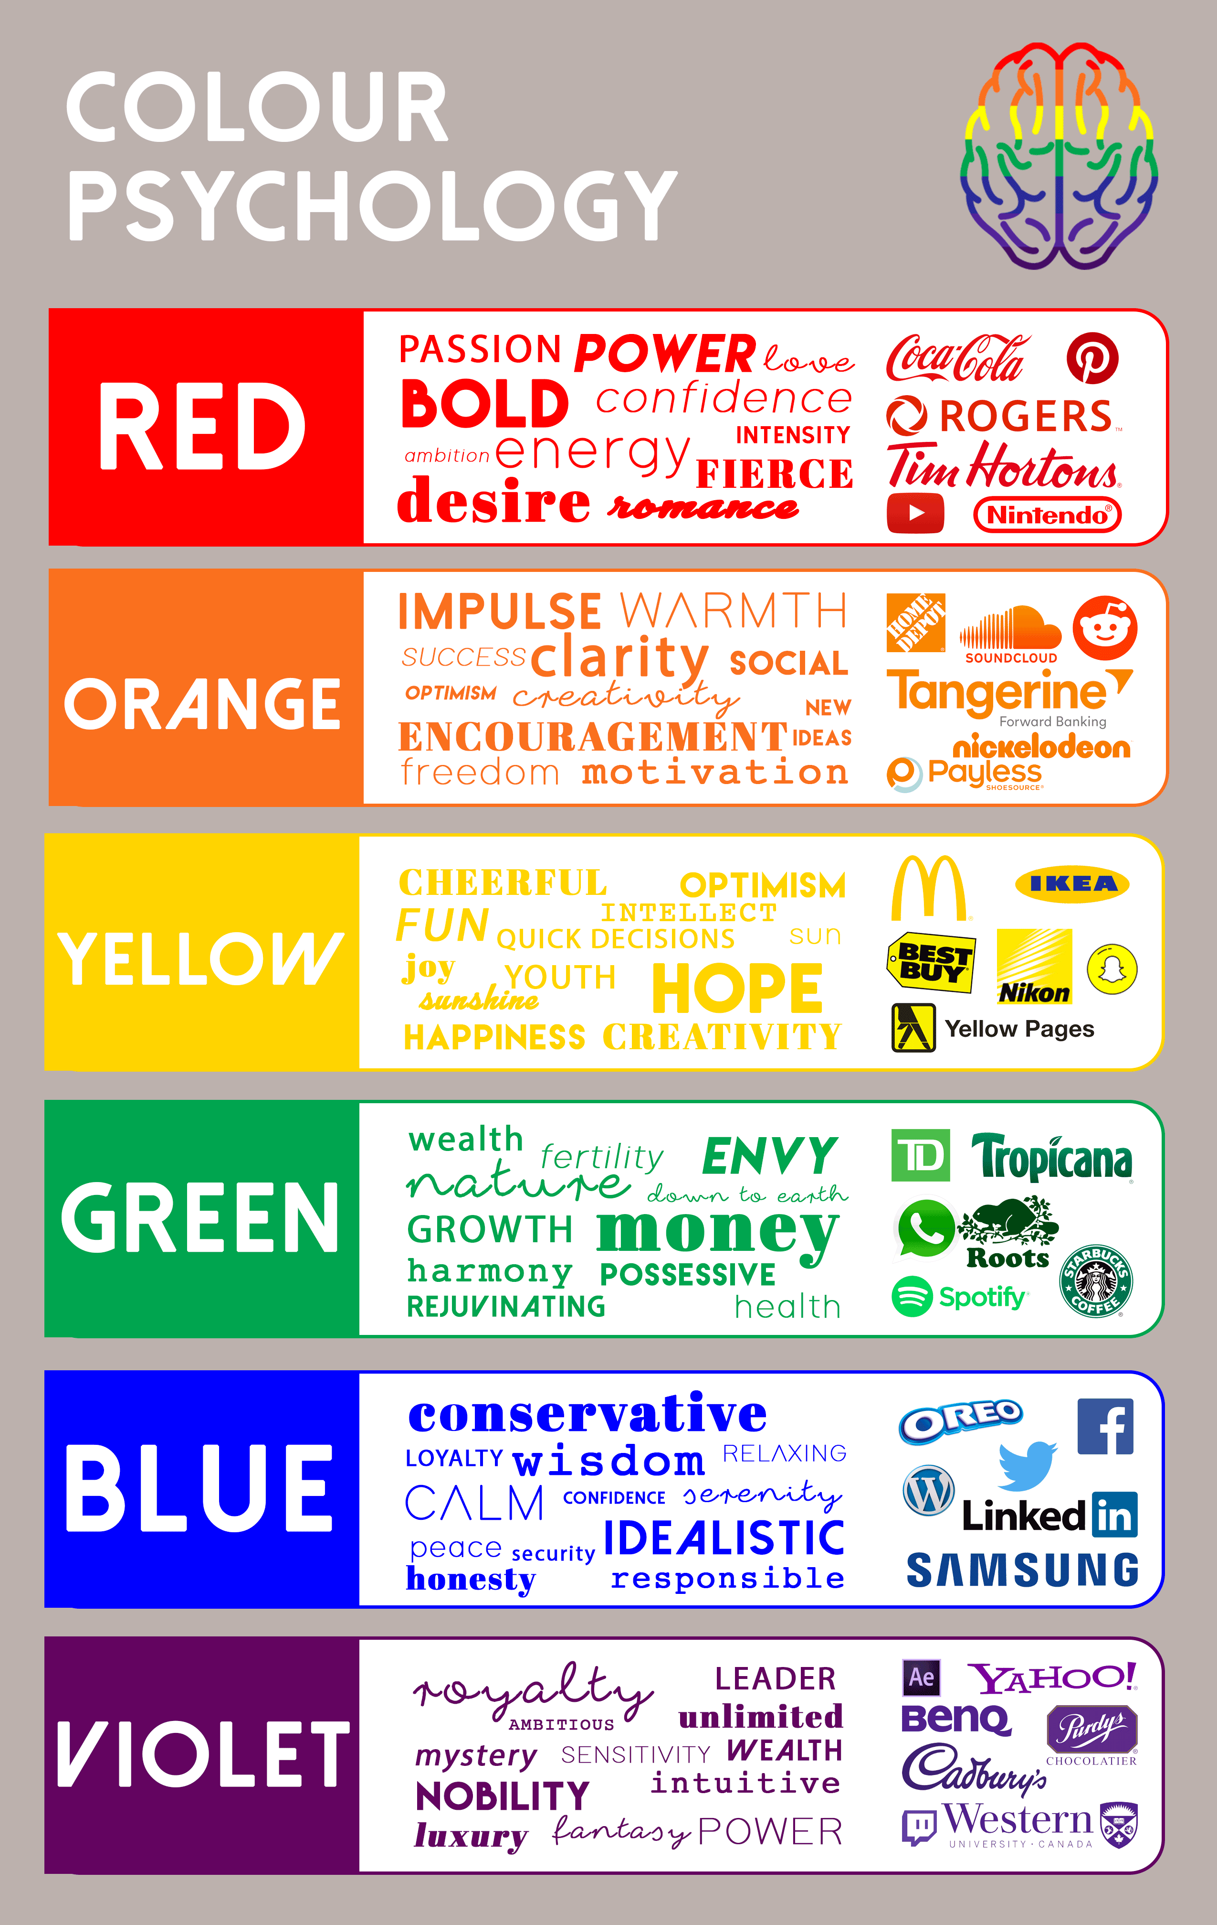
Color Theory and Its Impact on Design
Understanding Color Psychology
Different colors evoke specific emotions and associations; for instance, blue can convey trust and calmness, while red may evoke excitement or urgency, making color choice crucial in poster design.
Understanding Color Psychology
Different colors evoke specific emotions and associations; for instance, blue can convey trust and calmness, while red may evoke excitement or urgency, making color choice crucial in poster design.
Understanding Color Psychology
Different colors evoke specific emotions and associations; for instance, blue can convey trust and calmness, while red may evoke excitement or urgency, making color choice crucial in poster design.

Slide 13



Typography: Choosing the Right Fonts
Conveying Tone and Emotion
Different fonts evoke various feelings and associations; for instance, serif fonts often convey tradition and reliability, while sans-serif fonts can suggest modernity and simplicity, influencing the overall perception of the poster.
Consistency Across Design
Maintaining a consistent font style throughout the poster reinforces brand identity and visual coherence; using a limited number of complementary fonts helps create a unified look that enhances professional presentation.
Impact on Readability
The choice of font significantly affects how easily the audience can read and comprehend the information presented; selecting clear, legible fonts ensures that key messages are accessible to all viewers.

Slide 14
Incorporating Images and Graphics Effectively
02
Quality and Resolution
Use high-resolution images to maintain clarity and professionalism; pixelated or low-quality graphics can undermine the credibility of your poster and detract from its overall impact.
03
Strategic Placement
Position images and graphics thoughtfully within the layout to create visual interest and guide the viewer's eye; consider how they interact with text elements to maintain a balanced and cohesive design.
01
Choosing Relevant Images
Select images that directly relate to the content of your poster, ensuring they enhance understanding and support the main message rather than distract from it.

Slide 15
Setting Ground Rules for Presentations

Slide 16



Importance of Ground Rules in Presentations
Enhancing Audience Accountability
When ground rules are established, audience members are more likely to take responsibility for their participation, leading to a more productive session where everyone contributes meaningfully to the discussion.
Establishing Clear Expectations
Ground rules set clear expectations for behavior and participation, helping to create a respectful and focused environment that enhances audience engagement and interaction.
Promoting Effective Communication
By outlining communication protocols, such as time limits for questions and responses, ground rules facilitate smoother exchanges of ideas, ensuring that all voices are heard and valued during the presentation.

Slide 17

Examples of Effective Ground Rules
Respectful Communication
Encourage participants to listen actively and refrain from interrupting others, fostering a respectful atmosphere that promotes open dialogue and collaboration.
Time Management
Set specific time limits for presentations and discussions to ensure that all topics are covered efficiently, allowing equal opportunity for questions and contributions from the audience.
No Distractions Policy
Request that attendees silence their devices and avoid multitasking during the presentation, helping to maintain focus and engagement with the content being shared.

Slide 18
How to Communicate Ground Rules to Your Audience
01
Clear Introduction of Rules
Begin your presentation by explicitly stating the ground rules, ensuring that all audience members understand the expectations for behavior and participation from the outset.
02
Use Visual Aids
Incorporate visual elements such as slides or handouts that outline the ground rules, making them easily accessible and reinforcing their importance throughout the presentation.
03
Encourage Questions and Feedback
Invite audience members to ask questions or provide input on the ground rules, fostering a collaborative environment where participants feel valued and engaged in the process.

Slide 19



Enforcing Ground Rules During Presentations
Addressing Violations Promptly
Tactfully address any breaches of ground rules as they occur, using a calm and professional approach to maintain the integrity of the presentation while promoting accountability among participants.
Encouraging Peer Support
Foster a culture where audience members feel empowered to remind each other of the ground rules, creating a collaborative atmosphere that enhances engagement and collective responsibility during discussions.
Consistent Reminders
Regularly remind the audience of the established ground rules throughout the presentation to reinforce their importance and encourage adherence, ensuring a respectful and focused environment.

Slide 20
Best Practices for Poster Presentations

Slide 21
Preparing for Your Poster Presentation
01
Understanding Your Audience
Tailor your poster content and presentation style to the specific interests and knowledge level of your audience, ensuring that your message resonates and engages effectively.
02
Rehearsing Your Delivery
Practice presenting your poster multiple times to refine your speaking points, improve your confidence, and ensure you can convey your message clearly within the allotted time.
03
Preparing for Questions
Anticipate potential questions from the audience and prepare thoughtful responses; this will enhance your credibility and demonstrate your expertise on the topic being presented.

Slide 22

Engaging Your Audience During the Presentation
Interactive Questioning Techniques
Utilize open-ended questions throughout your presentation to encourage audience participation, fostering a dynamic dialogue that keeps attendees engaged and invested in the content.
Utilizing Visual Aids Effectively
Incorporate engaging visual aids, such as infographics or videos, to complement your spoken content; this not only captures attention but also reinforces key messages and enhances understanding.
Encouraging Audience Feedback
Create opportunities for audience feedback during the presentation, such as quick polls or discussions, to make participants feel valued and involved, ultimately leading to a more interactive and memorable experience.

Slide 23



Gathering Feedback and Improving Future Presentations
Importance of Constructive Feedback
Gathering constructive feedback from your audience helps identify strengths and weaknesses in your presentation, allowing you to make informed adjustments for future sessions and enhance overall effectiveness.
Utilizing Surveys and Questionnaires
Implementing post-presentation surveys or questionnaires can provide valuable insights into audience perceptions, preferences, and areas for improvement, ensuring that you address specific needs in subsequent presentations.
Encouraging Open Dialogue
Creating an environment that encourages open dialogue about the presentation fosters a culture of continuous improvement; inviting audience members to share their thoughts can lead to innovative ideas and better engagement strategies.

Slide 24
QUESTION 1
What is the primary goal of designing a poster for a presentation?
To include as much text as possible
To make it visually attractive
To convey a clear message effectively
To use multiple fonts and colors
Notes:
ANS:C

Slide 25
QUESTION 2
When selecting fonts for a poster, what should be considered?
Use as many different fonts as possible
Stick to one or two easy-to-read fonts
Use only decorative fonts
Use fonts that are extremely large
Notes:
ANS:B

Slide 26
QUESTION 3
Which of these is a visual aid?
Flip chartsTo make it visually attractive
Overhead Transparencies
Video tapes
All of these
Notes:
ANS:D

Slide 27
QUESTION 4
Visual aids are for ___________ purpose.
Illustrative
Decorative
Rhetorical
None of these
Notes:
ANS:A

Slide 28
QUESTION 5
Which of the following is important for creating an effective poster layout?
Overcrowding the poster with information
Ensuring the text is small to fit more content
Keeping a balance between text, images, and white space
Using complicated language
Notes:
ANS:C

Slide 29
QUESTION 6
What is the purpose of setting ground rules at the start of a presentation?
To control the audience
To establish clear expectations for interaction and behavior
To limit the discussion
To confuse the participants
Notes:
ANS:B

Slide 30
QUESTION 7
Which of the following is a good ground rule for maintaining audience engagement?
No questions allowed during the presentation
Participants can interrupt the speaker anytime
Questions should be saved for designated times
Phones must be on and checked regularly
Notes:
ANS:C

Slide 31
QUESTION 8
Which of the following should be avoided when setting ground rules for a presentation?
Encouraging respect and active listening
Allowing open dialogue at appropriate times
Encouraging side conversations during the talk
Maintaining a time limit for questions and responses
Notes:
ANS:C

Slide 32
QUESTION 9
Which of the following is NOT a recommended practice for designing an effective poster?
Using a clear and readable font
Including too much text
Utilizing visuals like graphs or images
Organizing content in a logical flow
Notes:
ANS:B

Slide 33
QUESTION 10
When setting ground rules for a presentation, which of the following is important?
Allowing interruptions at any time
Defining time limits for questions
Avoiding any audience participation
Making the presentation solely about the speaker
Notes:
ANS:B

Slide 34
THANK YOU

